Slide 1
Every child’s needs are unique and individual. We believe that it is vital that our pupils are equipped with the tools needed to become independent, inquisitive learners both inside and outside of the classroom to prepare for their future.
We have a variety of provision that we may use to support a child with additional needs, whether that be: emotionally, socially, learning, language, communication and interaction.

Slide 2

As well as a variety of well trained staff, some interventions and provision that we have available in school are below:
Cognition and learning:
Nessy (online programme) to support reading, spelling and memory.
RWInc (intensive reading and spelling programme)
Word Shark
Number Shark
Sound Linkage
Communication and interaction:
Speech and Language assistant – Mrs Hunt bespoke groups which could include following a SALT programme.
Language Link groups
Language for Understanding
Lego Therapy
Social, emotional and mental health:
Social Use of Language Programme
News Group
Thrive
ELSA
Physical and/ or sensory:
Occupational activities run by an LSA to support fine and gross motor skills
Writing slopes
Opportunities to use laptops or Ipads to record if appropriate promoting touch typing
Ear defenders
Wobble cushions
www.kingsfurlong.net

Slide 3
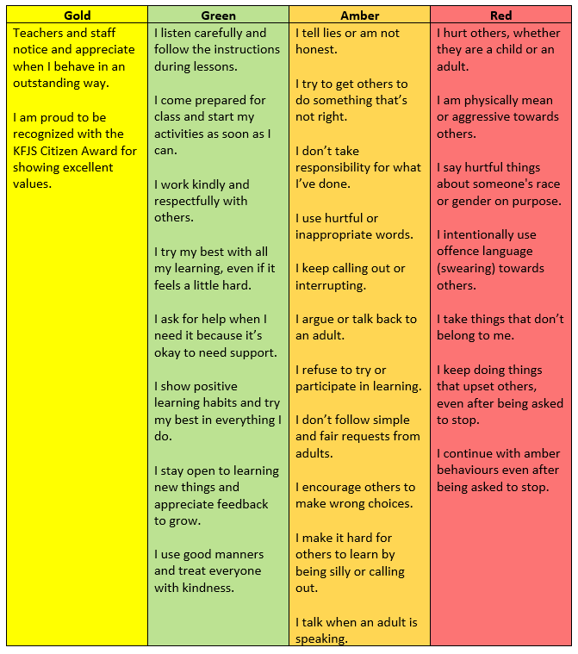
Behaviour policy –The emphasis of this policy is rewarding those who make positive and good behaviour choices, which the children really love because as a school we want the children to know that we value good behaviour.
www.kingsfurlong.net

Slide 4
Pastoral support
Mrs Steadman is our Behaviour and Mental Health Lead and Mrs Farmer is our Home School Link Worker.
At Kings Furlong Junior School we value the contributions the families of our children provide. We recognise that for a child to be happy and succeed, they need to be nurtured at home and at school to enable them to grow and flourish. As part of the Kings Furlong Junior school team, we work with families to help ensure that children are successful, happy and secure both in school and at home.
We have experience in supporting with a range of difficulties and can provide practical advice and support for the challenges we as parents/carers face along the way. These could include difficulties with children’s emotions, behaviour, sleep habits, attendance and any other need. Support around things such as: illness or bereavement, family breakdown, separation, domestic violence and financial difficulties.
In addition to this, we can help with completing forms, self referrals or simply just someone to listen and offload to. If we find some challenges along the way, we also have some excellent contacts with a number of outside agencies, which are also available to support families. Parents/carers, and staff within school can ask for our involvement, so sometimes we may contact you if the school has asked us too.
Together we will explore the challenges your child or family is experiencing and together try to find the best way forward. Please do not hesitate to contact us if you need anything.

Slide 5
At our school, we offer a variety of pastoral interventions to support children within school as we know how important it is to support their mental wellbeing. These are:
Thrive - Thrive is an assessment tool used throughout school for emotional support, connections and relationships. Thrive is delivered within the class for all children and there are also individual and small group sessions for targeted support. The individual and small group sessions are run by our pastoral worker: Mrs Irving, who is a trained Thrive practitioner.
ELSA/TALA –This is an intervention that focuses on supporting the emotional wellbeing of children. This intervention is run by Mrs Lampard, who is a trained practitioner. They are individual sessions, which are generally run over a 8 week period.
Therapy dog – we are lucky enough to have Ellie, who visits the school weekly to support children with their reading and emotional wellbeing.
Wellbeing Champions – we have a group of children that meet regularly to support and advocate for the mental health and wellbeing of children within school. They have arranged events and competitions to raise awareness for this.

Slide 6
Parent support workshops/coffee mornings – this can be with Mrs Steadman, Mrs Farmer and outside agencies. We have a different focus for each session. At the end of last year, we sent a survey out to parents asking what they would like so we have based the themes of the workshop on the needs of the parents. We will be sending this link out to you soon!
Parent support newsletter – we write and send these out every half term with a variety of different information of things can support parents.
Referrals – this can be through CAMHS, MHST, food bank and others.
Mrs Farmer works with parents and children together using thrive to help build relationships and boost confidence, bridge the gap between home and school and help identify children’s needs.

Slide 7
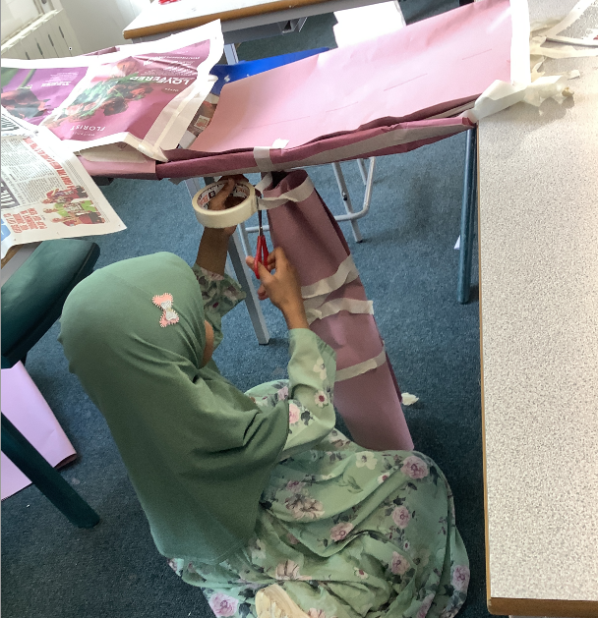
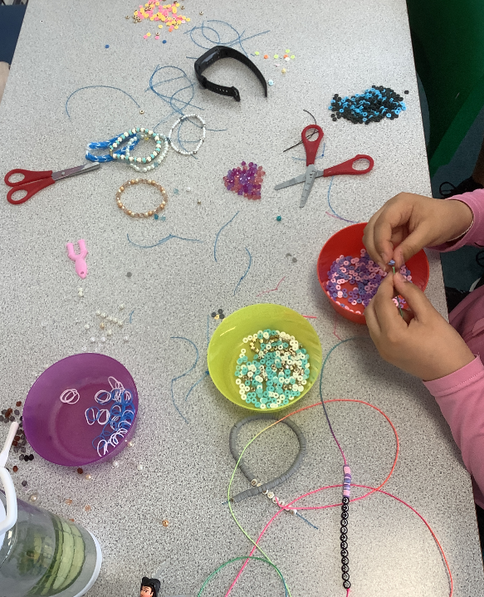
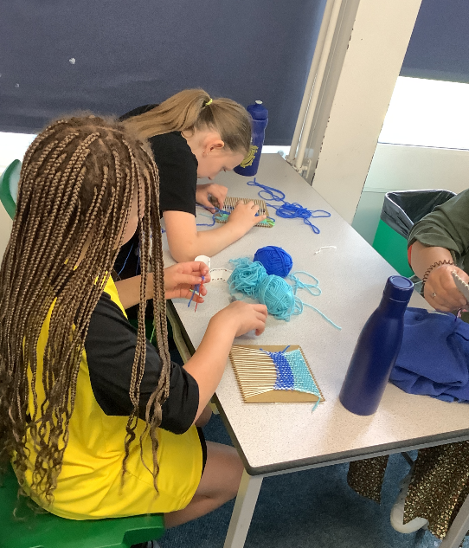
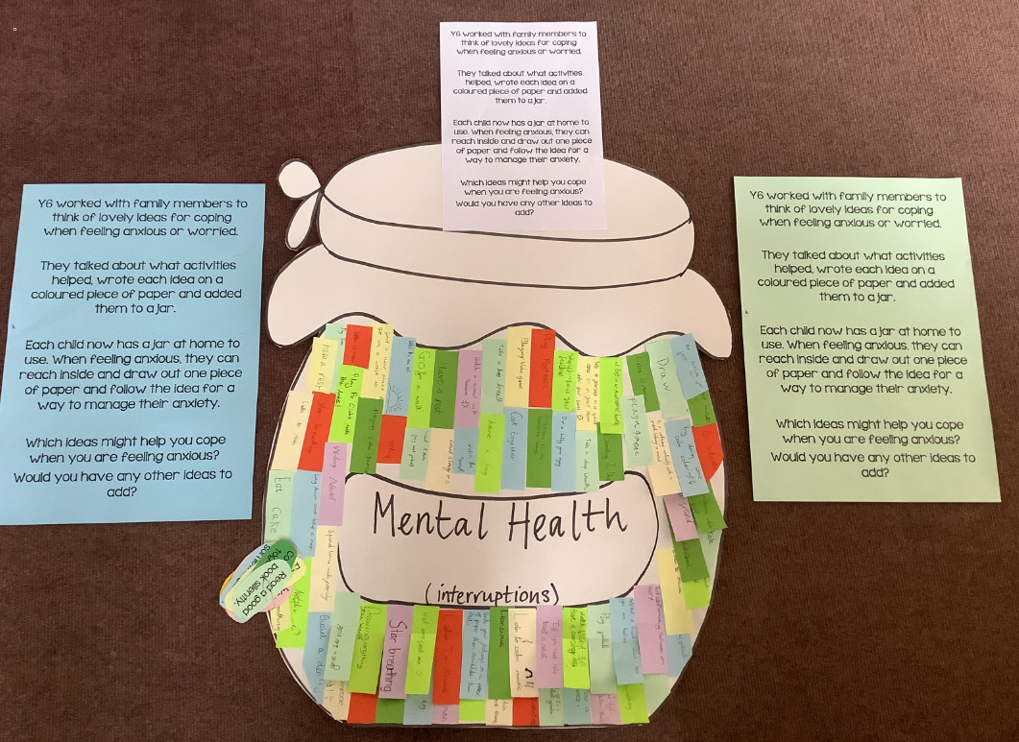
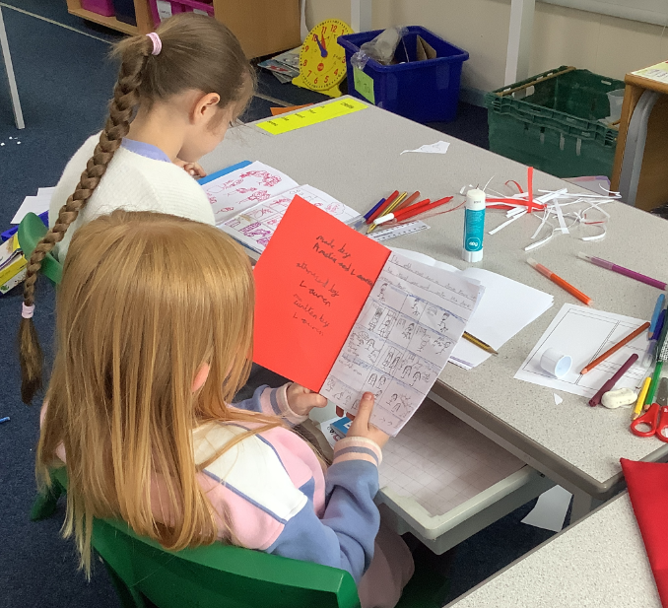
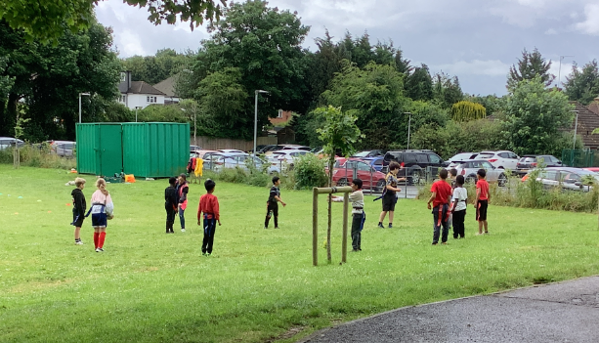
Mental Health Week 2024
The focus last year was on Anxiety. We looked at how anxiety can be both positive and negative and ways in which children can support themselves.
We then had our diploma morning at the end of the week where children took part in a range of activities that they signed up for. They were: football, rugby, bracelet making, science experiments, comic book making, tennis, recorders, taskmaster, creating a play, weaving and dragon making

Slide 8
Mental Health week – May 2024
Some comments from the children:
What did you learn?
-Learnt about anxiety and how it is a good thing
-Anxiety can help you overcome your fears
-There are different ways to cope
-Anxiety is more important than I thought: it is both good and bad
-I learnt how to calm down and get rid of worries
-Looking at ways to cope with big feelings and showing what the feelings are and what they look like
Did you learn any new strategies:
-Talk to someone as it makes your worries smaller
-Exercising
-Breathing strategies
-Having a diary to write down your thoughts and then you can show someone, which makes it easier to talk about.
-Tapping method – tap different parts of your body to help you refocus
-Taking yourself out of the situation

Slide 9
Mental Health week – May 2024
What did you enjoy most about the week:
-Diploma morning
-Dress to express yourself
-Walk and talks
-Having parents in to work with us
-Doing different activities over the week

