Slide 1

What do our children think about reading?
You can learn more vocabulary so you get smarter.
It’s good for your brain.
It gets me off my phone. A good book draws me in for hours.
I like to read non-fiction so I can learn about different things.
I can feel like I’m the main character.
I like fairy tales, they have happy endings.
www.kingsfurlong.net

Slide 2
I’m explaining 2 things this evening
Our learning points system
and
One of our most important jobs….

Slide 3
Reading

Slide 4
A love of reading
Children need to be able to read and to be able to read, it helps if the children have a love of reading!
You are much more likely to have aspirations and to achieve if you are a confident reader.
www.kingsfurlong.net

Slide 5
A love of reading….
is the most effective way a school can raise attainment and for our children to achieve.
We will soon be making final judgements about writing for Y6 – we can tell which children are avid readers because their writing ‘flows’.
www.kingsfurlong.net

Slide 6
How we teach reading in Y3
During the first week, the children come home with a reading book.
During the first three weeks, the children ‘warm up’ their phonics and participate in a range of activities linked to stories, fairy tales, poems and rhymes etc.
Some children will also have a phonological assessment.
At the end of 3 weeks, we carry out a phonics assessment. Using that and the KS1 phonics screening data, the children will be organised into reading groups – phonics or reading.

Slide 7
If it’s phonics…..
The phonics programme we follow is Read, Write Inc. Children are taught in small groups with a trained LSA for 30 minutes, 4 times a week.
The children are assessed around every 7 weeks and continue with RWInc until they are ready to join the reading lessons. If this is your child, Mrs Bennett, our phonics leader, will inform you.
There will be a RWInc event for parents in September if your child is on the programme. Please come to it if you are invited!
Some groups will also include learning other phonological skills (syllables, rhyming etc)

Slide 8
If it’s reading ….
The children read fiction, non-fiction or poetry to learn how to:
read with fluency
work out the meaning of unfamiliar words
infer
understand authors’ use of language
retrieve information.
www.kingsfurlong.net

Slide 9
Reading for Pleasure time every week
An opportunity for us to help the children:
Develop wider reading habits – try different authors and genres
Learn how to browse books
Discuss what they are reading and enjoying (or not)
Read in pairs or groups
Increase a love of reading

Slide 10
Book activities to promote reading
Regular story time in class
I Love This Book assemblies – a member of staff shares a good read
Weekly visit to the school library
Displays in the library to promote new or different books
Poetry Jam in October – each class performs a poem to the rest of the school.
Book Fair in December
World Book Day in March
Author visits

Slide 11
It’s teamwork
To help the children develop as readers, we expect them to read at home, with an adult, at least 4 days a week and for the adult to record it in the reading record.
This is logged in each class on a daily basis.
Every half term, I check every child’s home reading so I know which children are and are not engaging and need support.
www.kingsfurlong.net

Slide 12
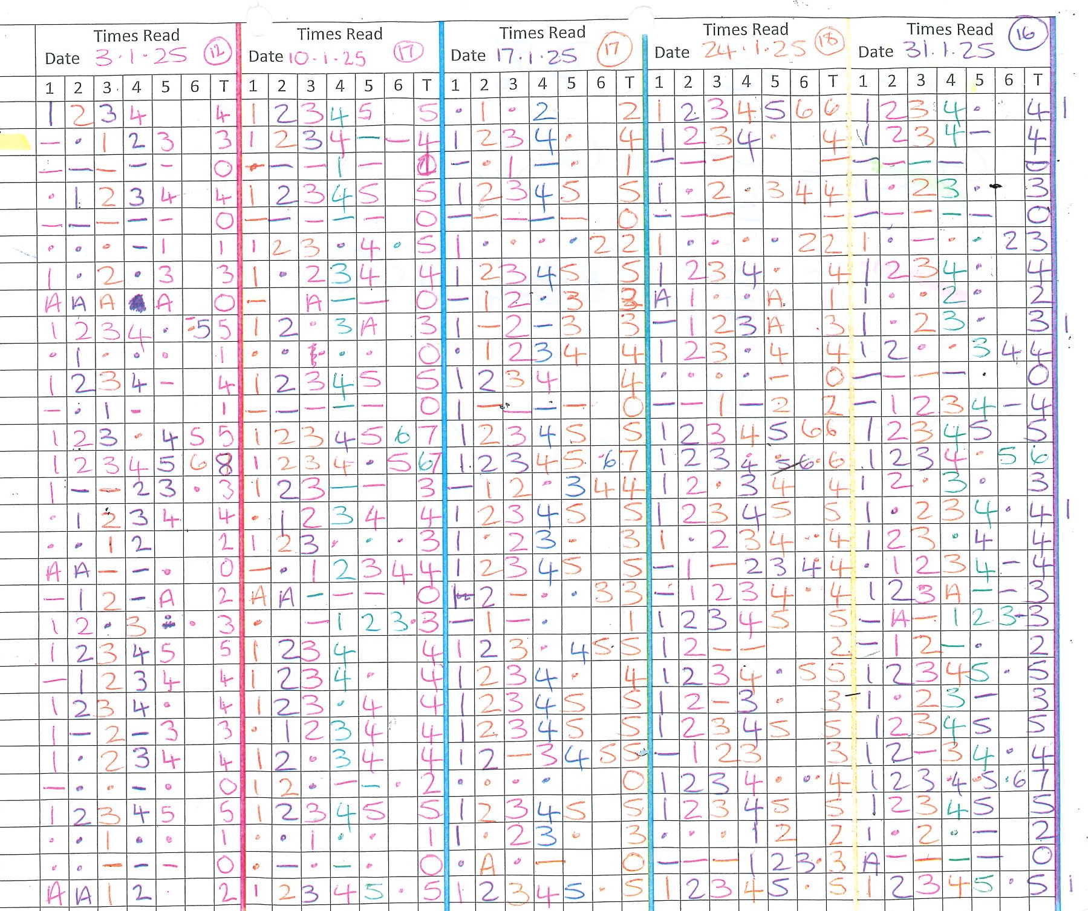
Home reading tracker
Which children probably don’t love reading yet?
www.kingsfurlong.net

Slide 13
My advice
Get into a good habit from the start – the children need to read to succeed.
Notes:
We want to reward children who are getting it right all of the time.
Some children need some extra support with their behaviour so they might be on a different system.
Now gold behaviour is very special….you need to be outstanding!!!!!
Green behaviour
Follows instructions and listens well during lessons
Organised for lessons and starts activities straight away
Works sensibly with others
Attempts all learning, even if it is a bit tricky
Asks for help if needed
Demonstrates all learning behaviours
Has a positive attitude towards learning and feedback
Demonstrates good manners
Gold
Shows kindness without prompting
Steps up and helps others
Members of staff comment on excellent behaviour
Presented with the KFJS citizen award

Slide 14
They give you something to work for.
I like getting them in lessons or my books because I can see I’ve worked hard.
What our children say about learning points.
They make me happy; I am proud of my work.
You can win Team of the Term party and have ice pops!

Slide 15
What is the point of learning points?
Learning points show the children we value their learning and effort and that they are doing well.
They are not for behaviour which is on a different system.

Slide 16

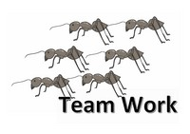






How do you earn learning points?
Working hard
Trying your best
Good work
Showing a learning behaviour – eg resilience or risk taking

Slide 17
What happens to the learning points?
Each child belongs to a colour team: blue, green, red or yellow.
When a child earns a learning point, it contributes to their colour team’s overall score.
At the end of each term, the colour team with the most points earns a treat.
Every half term, each class awards a gold, silver and bronze certificate to the 3 children with the highest number of learning points.

