Slide 1

Meet the Teacher
Welcome to Malala Class
www.kingsfurlong.net

Slide 2
I am Mrs Payne
Been at Kings Furlong for 18 Years
Primarily taught in Years 5 and 6
History lead – I love to listen to children exploring and questioning ideas. They are encouraged to consider the legacies of different periods in history.
www.kingsfurlong.net

Slide 3

BELONG
BELIEVE
ASPIRE
ACHIEVE

Slide 4
Learning in Year 6
River Wild – exploring the River Amazon and the people that use it
Read, Write and Remember to Twinkle – a chance for the children to compose
Don’t Forget the Batteries – creating a moving Christmas decoration to be displayed during our Christmas lunch
Welcome to Britain – learning how Britain has evolved in the last century due to immigration and migration
Life on Earth – understanding the evolution of animals
All Mixed Up – a science project investigating materials
Hip Hop Heaven – children compose a modern hip-hop song using technology
Ancient Adventures – comparing Mayan and Saxon civilisations
Circle of Life – building on our understanding of living things
Portraits Over Time – children appreciate portraits from the past as well as the present

Slide 5
Learning in Year 6
The elephant in the room – SATs. Are they really that bad? No.
Our philosophy is that as long as the children walk into that room feeling confident and out knowing they’ve tried their best, then we’re happy.
How can you help get the best out of your children? Ensure they do a great job of all of their home learning.
We’ll share so much more information about them at Parents Evening and SATs Information Evening.
Please don’t panic.
www.kingsfurlong.net

Slide 6
Learning in Year 6
Our core curriculum continues to build on what the children have learnt so far
  In English, children will further develop their ability construct sentences and paragraphs which are fit for purpose.
  In maths, we will develop fluency in all four operations as well as fractions, decimals and percentages. Once this is in place, children will be better equipped to solve problems.
  In reading, children are explored to wide variety of texts. We use these as a vehicle to develop their understanding of vocabulary, retrieve information quickly and infer meaning.
www.kingsfurlong.net

Slide 7
Reading – a love of reading is the most effective way to raise attainment.
All children are expected to read at home at least four times a week. Stamina in Year 6 should last for at least 15 minutes.
Their reading log still needs to be signed by an adult.
It is no surprise that the children who read the most at home, do better in their SATs and are most ready for secondary school.
www.kingsfurlong.net

Slide 8
Reading – a love of reading is the most effective way to raise attainment.
Children visit our library regularly because we want the children to read a wide variety of books.
SORA is a great, and free, way of exploring new authors – children already have login details in their home reading books.
www.kingsfurlong.net

Slide 9
Home learning
Reading 4 times a week
Spelling – we will be sending home a half-termly spelling overview for your information. ‘Orange’ words will come home too to practise.
Times Table Rock Stars – 10 minutes twice a week ideally. Sound Check and Studio are best for Year 6.
After Christmas, the intensity increases with personal study books.
There will also be an Easter homework pack (this will be the only time we ask them to do anything big over the holidays)
www.kingsfurlong.net

Slide 10
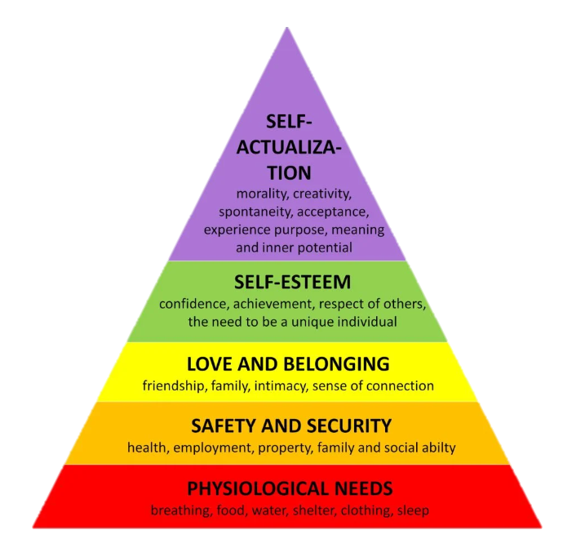
Thrive
Thrive supports emotional development, behaviour and it also helps support children who struggle to come to school.

Slide 11
Thrive
There are two trained practitioners within the school that can run Thrive sessions.
Thrive sessions can be either 1-1 or in small groups based on the need of the child. We also run thrive sessions with parents and their child, which is supported by our Home School Link Worker.
Those that have either 1-1 or group sessions with our trained practitioners will have termly reports that are sent home so you can see the targets they are working on and how you can support them at home.

Slide 12
Activities in Year 6 this year
Avon Tyrell – if you’ve changed your mind and now want to go, it’s not too late to sign up but you must do so by the end of this month
Zoo in school – children will handle a range of creatures who have adapted to their environment
Ancient Adventurer – an expert in Mayan culture brings our history project alive.
Still to be confirmed (depends on how much we raise from the Spelling Bee): after SATs celebration, Bowling and Hide and Seek
End of Year 6 performance
Leavers’ songs and speeches
www.kingsfurlong.net

Slide 13
Events for you to join
Avon Tyrell meeting – 16th December
Pre-SATs meeting - 12th March
End of year production – 8th July
Leavers’ songs and speeches – their last ever day!
www.kingsfurlong.net

Slide 14
School uniform and PE kit
Children are expected to wear the correct uniform at all times. Shirts/t-shirts need to be tucked in.
Hair bands, ribbons/bows or ‘scrunchies’ should be plain and either blue or black and of a sensible size.
The only jewellery that children are permitted to wear to school is stud ear-rings and small items of religious significance. Hooped earrings are not allowed.
Children may only wear trainers on PE days. If they wear trainers on a school uniform day, they will be given school plimsolls to wear.
For PE, the children need to wear their colour team t-shirt and a non-branded sweatshirt/hoodie.
Check our website at kingsfurlong.net for the full list of school uniform and PE.
The children will be able to purchase a leavers’ hoodie early next year, which will become part of their PE kit.

Slide 15
Social media
We are aware that many of our children are accessing social media apps like ‘WhatsApp’ and TikTok
The age limit for a WhatsApp or TikTok account is 13.
Our experience over recent years has been that the number of our children in group chats is increasing.
The children do not yet have the maturity to manage the emotions that negative messages bring or to access the content that is available which is why the apps are not for children.
If you allow your children to have these apps, be prepared to deal with the consequences.
To help you with this, there is a workshop with Eduthing, our network provider, about managing social media and keeping your child safe online on Thursday 19th September 5:30pm. Please try to attend!
www.kingsfurlong.net

Slide 16
Attendance and Lateness
Good attendance starts with close and productive relationships with parents and children.
We expect children to be on time and attend school every day.
Doors close at 8:45am. If your child arrives after this time they will be marked as late
If your child is not well enough to attend school you must let the office know
If you are struggling to get your child into school – let us know, don’t let them stay at home. We have a great team who can help!
If attendance drops below 90% we will contact you to see if we can offer any help. We can contact the school nurse if there are medical worries or look at if we need to offer emotional support
All children who have attendance under 90% are tracked and monitored by Miss Westaway
Poor attendance impacts on learning – it is difficult for the children to fill in the gaps if they regularly miss parts of our learning journeys.
Remember communication is key – if we don’t know about any worries, we can’t help!

Slide 17
Communication
All children have a yellow home school book which should be in school every day and taken home each night.
We use Arbor to send messages and emails. Please read them because we send a lot of information this way. Any problems with accessing the app please see the office.
Half termly newsletter with all of the key dates on it. This will come to you via email at the start of each half term.
We will contact you if your child has landed on red or gold on our behaviour system.
Please let us know if there is a change in circumstances or a problem which will affect your child even if you think they are dealing with it. Phone the office and ask us to call and we will get back to you as soon as we can. Working as a team is absolutely the best thing for your child!
www.kingsfurlong.net

Slide 18
Check out our website!
https://www.kingsfurlong.net/
We have a wealth of information on our website.
School policies, letters and key dates
Uniform and PE kit expectations
Information about what your child will be learning over the year
Parent information on supporting your child with behaviour and mental health plus support for you!
Plus much, much more!
www.kingsfurlong.net

Slide 19
www.kingsfurlong.net

Slide 20
www.kingsfurlong.net

Slide 21
www.kingsfurlong.net

Slide 22
www.kingsfurlong.net

Slide 23
www.kingsfurlong.net

Slide 24
www.kingsfurlong.net

Slide 25
www.kingsfurlong.net

Slide 26
www.kingsfurlong.net

Slide 27
www.kingsfurlong.net

