Slide 1


Meet the Teacher
Welcome to Peake Class
www.kingsfurlong.net

Slide 2
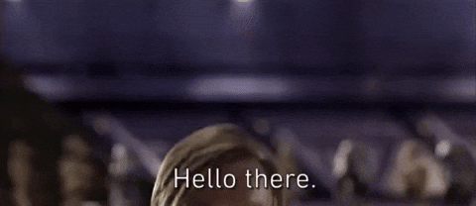
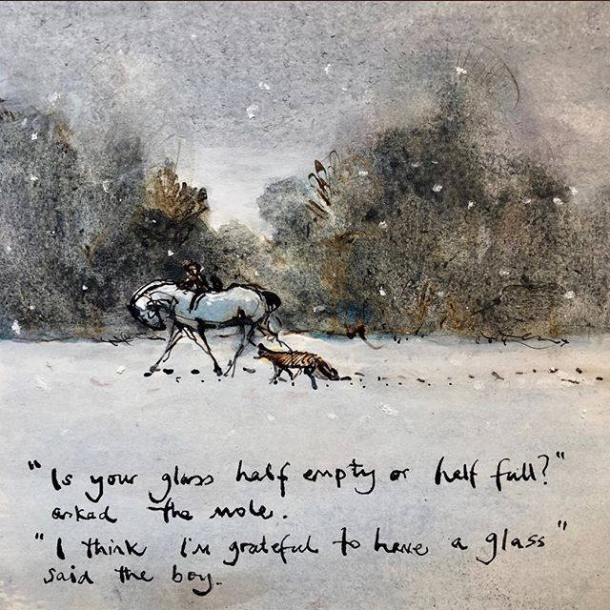
I am ….. Mr Therisa
My favourite hobbies are to read, play video games and visit friends. I’ve also recently got back into golf.
I am a huge Star Wars fan (as some of you may already be aware).
My favourite subject in school has always been Maths.
My favourite books are Percy Jackson: Mark of Athena, ‘I want my hat back’ by Jon Klassen and ‘The Boy, the mole, the fox and the horse’ by Charlie Mackesy.
My favourite quotes are: ‘Hello there’ (as seen above) and ‘The greatest teacher, failure is.’ by Yoda (also from Star Wars).
www.kingsfurlong.net

Slide 3

BELONG
BELIEVE
ASPIRE
ACHIEVE

Slide 4
Team Work
Risk Taking
Respect
Resilience
KFJS Learning
Behaviours
Reflection
Curiosity
Creativity
Responsibility

Slide 5
Learning in Year 3
The Savvy Stone Age (history and art)
What’s Happening Now? (geography and DT)
Lights Out (science)
Feel the Force (science)
Trip Advisor (geography and art)
Easter (music)
Flower Power (science, art and DT)
Good Vibrations (science and music)
Marching Romans (history and music)

Slide 6
Reading – a love of reading is the most effective way to raise attainment.
All children are expected to read at home at least four times a week.
Reading logs need to be signed by an adult.
Children who read at home, do better in their SATs and are most ready for secondary school.
www.kingsfurlong.net

Slide 7
Reading – a love of reading is the most effective way to raise attainment.
Children visit our library regularly because we want the children to read a wide variety of books.
SORA is a great, and free, way of exploring new authors – children already have login details in their home reading books.
www.kingsfurlong.net

Slide 8
Home learning
TTRS – Times Table Rock Stars. This is key learning for fluency each child must go on at least once a week.
Creative homework set every half term – this is linked to the project eg making a Roman shield. This could be a letter, a poster, a PowerPoint, a picture or something 3 dimensional.
We also send home spelling keyword overviews for you to help your child to learn the statutory ‘orange words’ (or red) set by the DfE.
Our half-termly newsletter will outline the spelling rules and patterns that groups will explore each half term with examples for you to use and expand on.
www.kingsfurlong.net

Slide 9
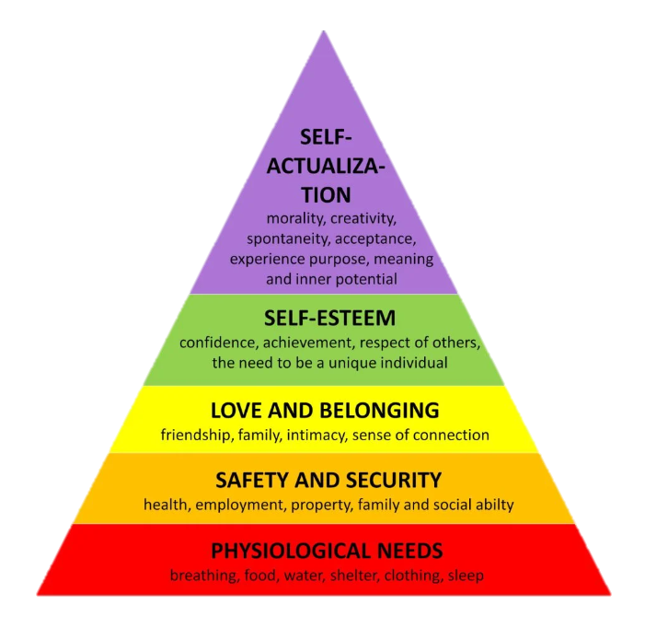
Thrive
Thrive supports emotional development, behaviour and it also helps support children who struggle to come to school.

Slide 10
Thrive
There are two trained practitioners within the school that can run Thrive sessions.
Thrive sessions can be either 1-1 or in small groups based on the need of the child. We also run thrive sessions with parents and their child, which is supported by our Home School Link Worker.
Those that have either 1-1 or group sessions with our trained practitioners will have termly reports that are sent home so you can see the targets they are working on and how you can support them at home.

Slide 11
Activities in Year 3 this year
Stonehenge trip – 14/10/25
Local walk – 12/11/25
QMC science centre – 1/12/25
Local park trip – 7/1/26
Science Fayre – 9/2/26
Easter singing show – 26/3/26
Roman visitor – 7/7/26
www.kingsfurlong.net

Slide 12
Events for you to join
Read Write Inc. (phonics) workshop for parents – 21/10/25
Science fayre - 9/2/26
Easter Singing show – 26/3/26 afternoon
Mental Health Week workshop – 3/6/26
Check the website for whole school events throughout the year.
www.kingsfurlong.net

Slide 13
School uniform and PE kit
Children are expected to wear the correct uniform at all times. Shirts/t-shirts need to be tucked in.
Hair bands or ‘scrunchies’ should be plain and either blue or black and of a sensible size.
The only jewellery that children are permitted to wear to school is stud ear-rings and small items of religious significance. Hooped or dangling earrings are not allowed.
Children may only wear trainers on PE days. If they wear trainers on a school uniform day, they will be given school plimsolls to wear.
For PE, the children need to wear their colour team t-shirt and a non-branded sweatshirt/hoodie.
Check our website at kingsfurlong.net for the full list of school uniform and PE.

Slide 14
Social media
We are aware that many of our children are accessing social media apps like ‘WhatsApp’ and TikTok
The age limit for a WhatsApp or TikTok account is 13.
Our experience over recent years has been that the number of our children in group chats is increasing.
The children do not yet have the maturity to manage the emotions that negative messages bring or to access the content that is available which is why the apps are not for children.
If you allow your children to have these apps, be prepared to deal with the consequences.
www.kingsfurlong.net

Slide 15
Attendance and Lateness
Good attendance starts with close and productive relationships with parents and children.
We expect children to be on time and attend school every day.
Doors close at 8:45am. If your child arrives after this time they will be marked as late
If your child is not well enough to attend school you must let the office know
If you are struggling to get your child into school – let us know, don’t let them stay at home. We have a great team who can help!
If attendance drops below 90% we will contact you to see if we can offer any help. We can contact the school nurse if there are medical worries or look at if we need to offer emotional support
All children who have attendance under 90% are tracked and monitored by Miss Westaway
Poor attendance impacts on learning – it is difficult for the children to fill in the gaps if they regularly miss parts of our learning journeys.
Remember communication is key – if we don’t know about any worries, we can’t help!

Slide 16
Communication
All children have an orange home school book which should be in school every day and taken home each night.
We use Arbor to send messages and emails. Please read them because we send a lot of information this way. Any problems with accessing the app please see the office.
Year group termly newsletter provides you with all relevant information for the half term ahead. This will come to you via email at the start of each half term.
We may contact you if your child has landed on red (on the behaviour system) to discuss how we can provide further support.
Please let us know if there is a change in circumstances or a problem which will affect your child even if you think they are dealing with it. Phone the office and ask us to call and we will get back to you as soon as we can. Working as a team is absolutely the best thing for your child!
www.kingsfurlong.net

Slide 17
Check out our website!
https://www.kingsfurlong.net/
We have a wealth of information on our website.
School policies, letters and key dates
Uniform and PE kit expectations
Information about what your child will be learning over the year
Parent information on supporting your child with behaviour and mental health plus support for you!
Plus much, much more!
www.kingsfurlong.net

Slide 18
www.kingsfurlong.net

Slide 19
www.kingsfurlong.net

Slide 20
www.kingsfurlong.net

Slide 21
www.kingsfurlong.net

Slide 22
www.kingsfurlong.net

Slide 23
www.kingsfurlong.net

Slide 24
www.kingsfurlong.net

Slide 25
www.kingsfurlong.net

Slide 26
www.kingsfurlong.net

