Slide 1

Welcome to Kings Furlong Junior School
Parents Information Meeting
www.kingsfurlong.net

Slide 2
Belong
Believe
Aspire
Achieve

Slide 3
What role do you play?
BELONG
Encourage participation in school events, extra curricular activities, and clubs to help children feel connected.
Model inclusivity at home — promote respect for others, talk positively about differences, and support friendships with a diverse range of peers.
Build relationships with adults in the school community and other families to create a strong support network.
Create routines that show school is a valued and safe place to be.
BELIEVE
Nurture confidence and a positive mindset
Express belief in your child’s potential — praise effort, not just outcomes.
Help them overcome self-doubt by talking through challenges and celebrating progress.
Share stories of resilience (your own or others) to show that setbacks are part of learning.
Work with us so we can support your child in areas where they struggle.

Slide 4
ASPIRE
Encourage goal-setting and big dreams
Talk about the future positively — ask about their ambitions and encourage exploration of interests.
Expose them to role models — from books, community, or your own life — who show what’s possible with effort.
Set shared goals (academic and personal) and track progress together.
Promote curiosity by encouraging questions and seeking answers together.
ACHIEVE
Support learning and celebrate success
Establish a homework routine and a quiet space to learn.
Communicate with teachers to understand expectations and how to support learning at home.
Recognise accomplishments, big or small, academic or personal — growth matters.
Encourage time management and responsibility so children learn to take ownership of their learning.

Slide 5
Where do we start?
Communication is key!
Newsletters & website
Parent texts and emails (make sure we have your most recent details!) via the Arbor APP
Home school books are the best way to get an instant message to a teacher
Call the office to make an appointment
Pop in if urgent, there will always be someone who can help!
We have an open door policy!
www.kingsfurlong.net

Slide 6
Learning Behaviours
Belong
Team work
Respect
Reflection
Resilience
Creativity
Curiosity
Responsibility
Risk taking
Believe
Aspire
Achieve
www.kingsfurlong.net

Slide 7
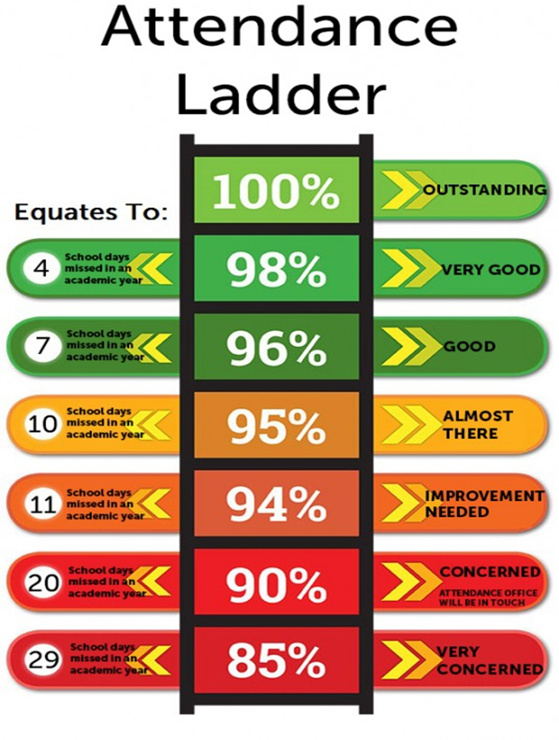

Slide 8
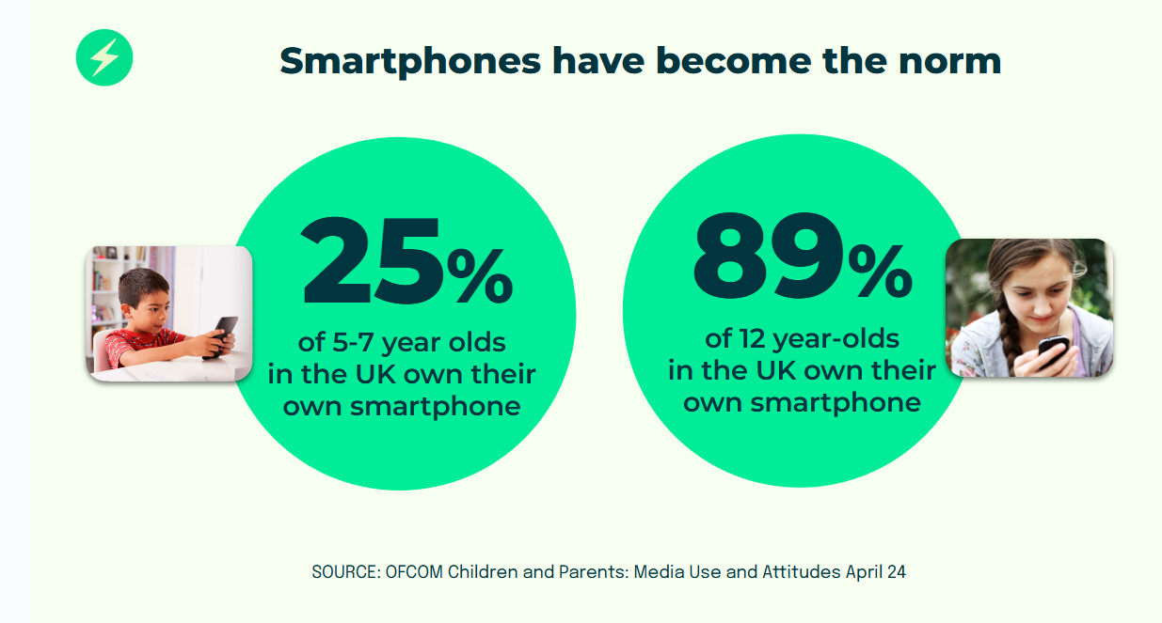

Slide 9
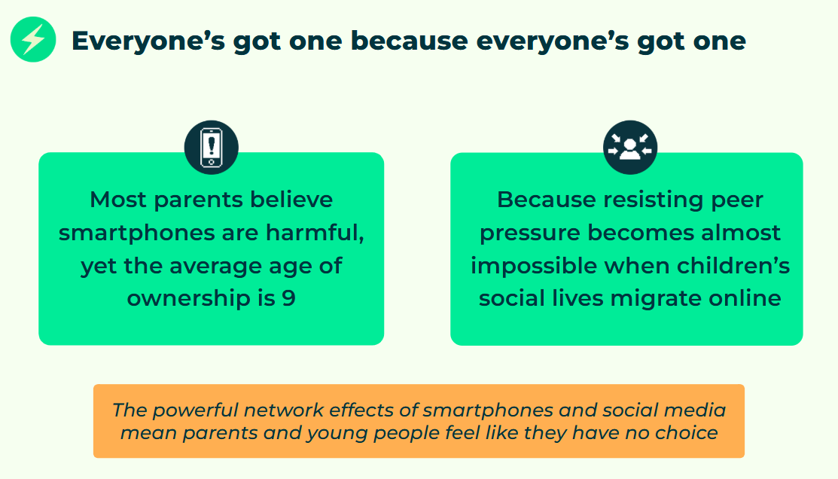

Slide 10
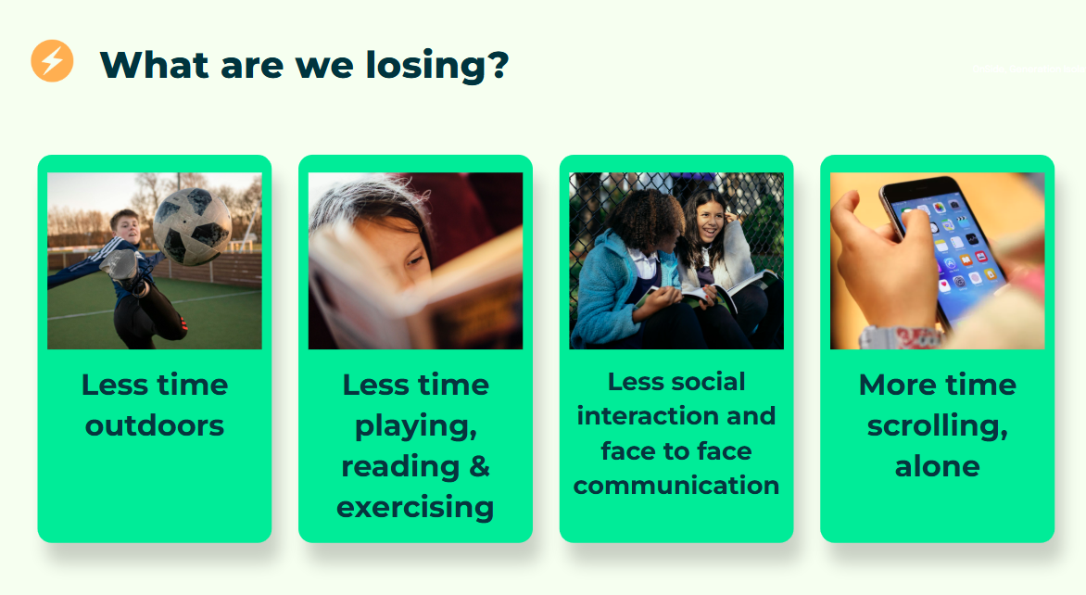

Slide 11
Logistics…When and Where?
Children are expected to arrive at school at 8:40am (this is when the gates are opened). Doors close and register is taken at 8:45am.
Children must not arrive before this time, as they will not be supervised and the school gate will not be open
School finishes at 3:15pm.
We expect children to arrive at school on time, this is monitored weekly. Children will be asked for reasons.
We ask parents to drop off at the gate. During the 1st week we allow Y3 parents to bring their child onto the playground so they get used to routines
At the end of the day parents collect from the playground
www.kingsfurlong.net

Slide 12
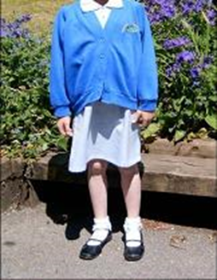
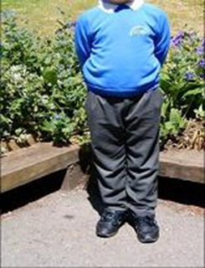
Uniform
Where possible children are expected to wear a jumper or cardigan that displays the school logo. If this is not possible, a plain blue jumper/cardigan is acceptable
Fleeces are the only optional branded items
Expected uniform
Grey/black skirt, trousers (not skinny jeans), shorts, skorts or pinafore. Skirts and shorts must be of an appropriate length
White blouse or white polo shirt
Leggings can only be worn under skirts or for PE
Electric/royal blue school sweatshirt/cardigan with school logo
Blue and white summer checked dresses (checked skorts are also acceptable)
Black, grey or white socks or tights.
Shoes must be black (without colour or strips). High heels, open toes, sling backs, platforms and trainers are not acceptable.
Flat boots may be worn but must be plain black.
www.kingsfurlong.net

Slide 13
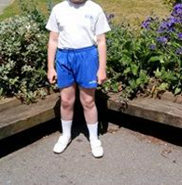
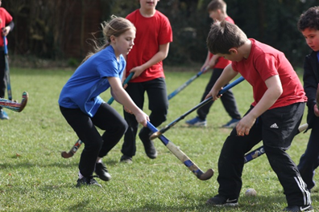
Sports Kit
Outdoor: Plain black/navy or grey tracksuit bottoms and jumper. Plain coloured t-shirt (available from the office for £2.50 each). Trainers (preferably black or white).
Indoor: Plain black or blue shorts, plain coloured t-shirt,
plimsolls or trainers
No branded sports wear.
Colour Team t-shirt
You will be told your child’s colour team
and will be able to purchase a
colour t-shirt from the office for £2.50. The
office will be selling these toward the end of the
term – they will send a message out to let you know.
Earrings must not be worn
www.kingsfurlong.net

Slide 14

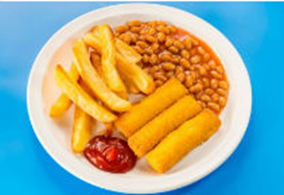

Food and Drink
You need to order school dinners online via Scopay before 8:30am. The office can help you set this up. Children will no longer need to order dinners from school.
There are 3 options; red, green and jacket potato.
The government scheme does not fund junior school meals so you will need to pay £3.20 per meal.
Children are encouraged to bring a healthy snack to eat at playtime and a water bottle (with their name on!) The junior school does not provide free snacks.
Please inform the school if your child has any dietary needs.
We are a nut free school.
www.kingsfurlong.net

