Slide 1
Welcome
Please use this time to look through SATs papers from previous years. Your child will sit something very similar in May this year.
Sorry, these papers are for the children and NOT for you to keep.

Slide 2
Date | Assessment
Monday 11th May | Spelling, punctuation & grammar (2 separate tests)
Tuesday 12th May | English Reading Three short texts with lots of questions to answer
Wednesday 13th May | Maths – arithmetic (no words, just calculations) Maths – reasoning (solving problems)
Thursday 14th May | Maths – reasoning (solving problems)

Slide 3
What are the SATs for?
They are a snapshot of a child’s achievement. It will help secondary schools identify who will need further support and challenge in September.
It supports schools in measuring how much progress children have made during their school life so far.
It helps secondary schools measure progress as they move through Key Stage 3 and 4.

Slide 4
How will the tests be marked?
In the end of year report, you will be given your child’s scaled score and whether they have reached the expected standard set by the Department for Education.
The range of scaled scores available for each KS2 test is:
80 (the lowest scaled score that can be awarded)
120 (the highest scaled score)
The expected standard for each test is a scaled score of 100 or more. If a child is awarded a scaled score of 99 or less they won't have achieved the expected standard in the test.
Scaled scores of 110 and higher indicates that the children are working at a Greater Depth.
All of these assessments are marked externally and we will not find out the scores until a couple a days before the reports go out.

Slide 5
A typical scaled score
Expected
Greater Depth
 | Raw score | Scaled score | Raw score | Scaled score
Reading | 27/50 | 100 EXS | 40/50 | 110 GDS
SPAG | 38/70 | 100 EXS | 56/70 | 110 GDS
Which could be achieved by … | Grammar 28/50 |  | Grammar 42/50
 | Spelling 10/20 |  | Spelling 14/20
Maths | 60/110 | 100 EXS | 95/110 | 110 GDS
Which could be achieved by … | Arithmetic 30/40 |  | Arithmetic 37/40
 | Reasoning 15/35 |  | Reasoning 29/35
 | Reasoning 15/35 |  | Reasoning 29/35

Slide 6
What about the writing?
How do writers persuade?
Teaching
Independent
They plan
They select the vocabulary
They choose the best sentence types
They edit
They can get peer support and use anything we’ve used to help them.
Immersing ourselves in good examples to help hear the voice and understand the purpose
Developing vocabulary
Exploring sentences structures
Structuring paragraphs
Practising editing.
By mid June, children will have a collection of independent work.

Slide 7
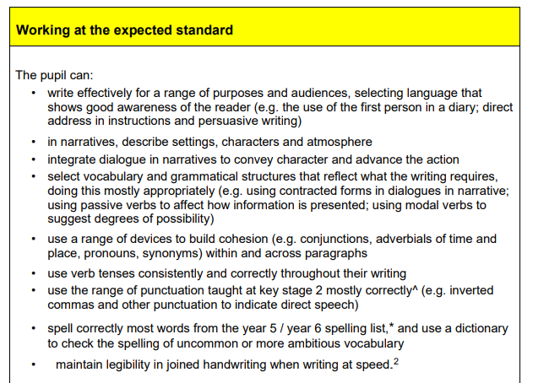
Children must be able to demonstrate ALL of these in order to be judged as working at the expected standard.
For more information, search KS2 writing framework

Slide 8
Leading up to the SATs
Tips for the week
Reading at least 4 times a week for at least 10 minutes
Reading a range of texts
A good routine for their CGP books
Mathsbot.com / arithmetic / KS2
A water bottle
A good night’s sleep
Breakfast
A snack
Leaving home with a smile
As normal as possible

Slide 9
Reminder: Leave the test here for the children
Any questions?
This presentation will be available for viewing in the Year 6 section of the school’s website.

