Slide 1
Avon Tyrrell
The best week ever!
At the back of the room, you will find:
A medical form with your child’s name on (please return to school as soon as possible)

Slide 2
Who’s going?
Mr Hanson
Miss Dunn
Mr Charles
Mrs Payne
Mrs Lamont
Mrs Hasler
Mr Payne

Slide 3
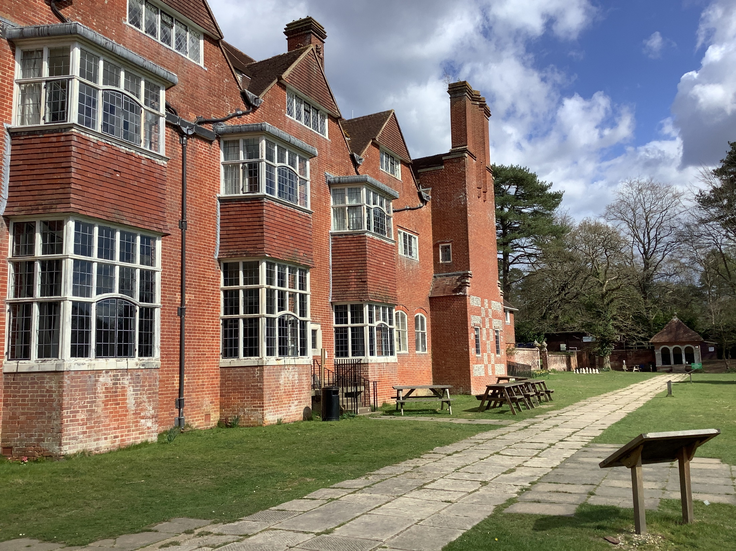

Slide 4
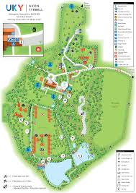

Slide 5
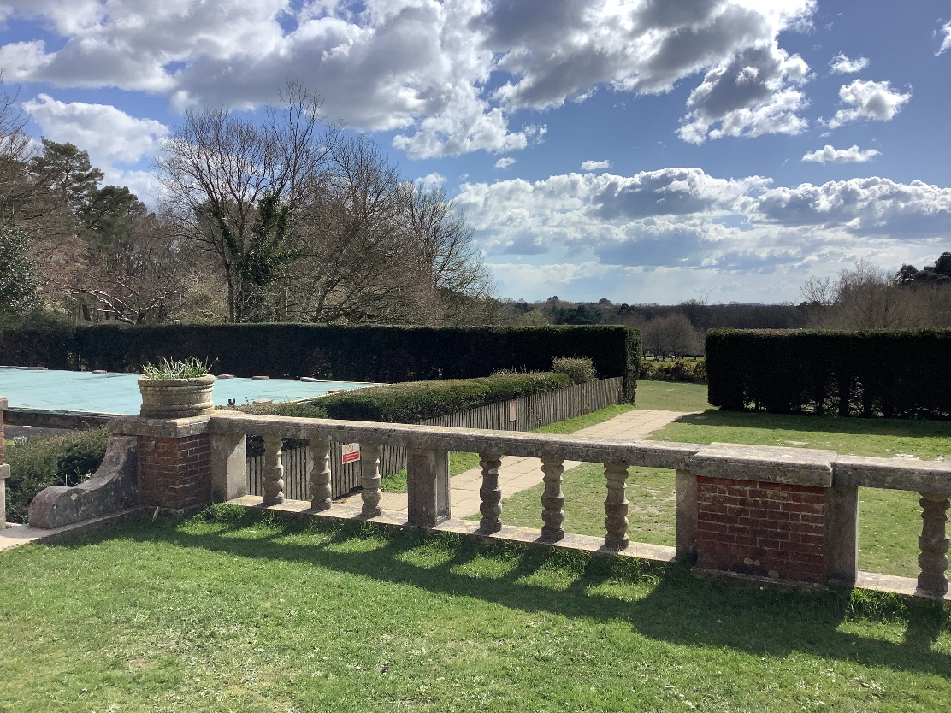
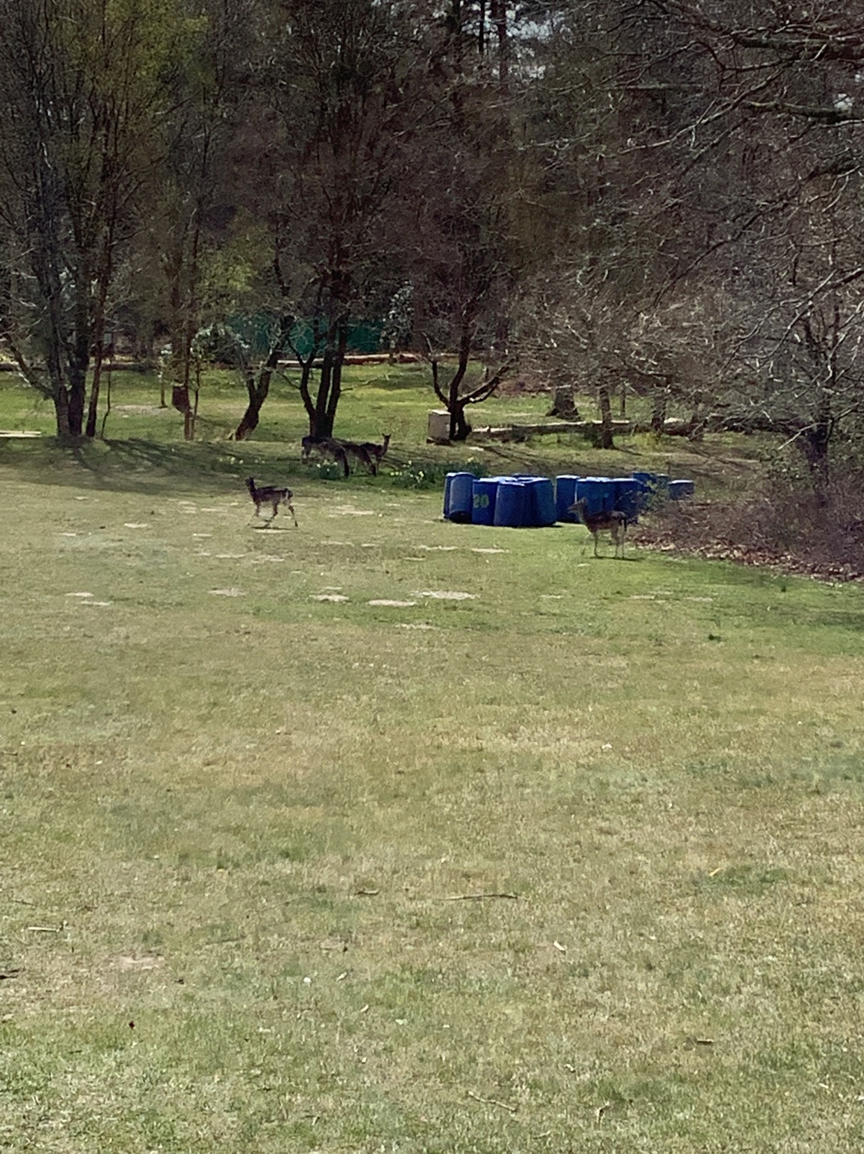
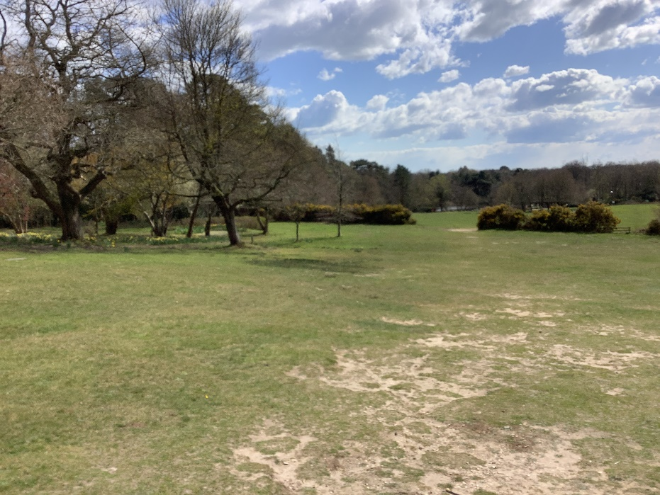

Slide 6
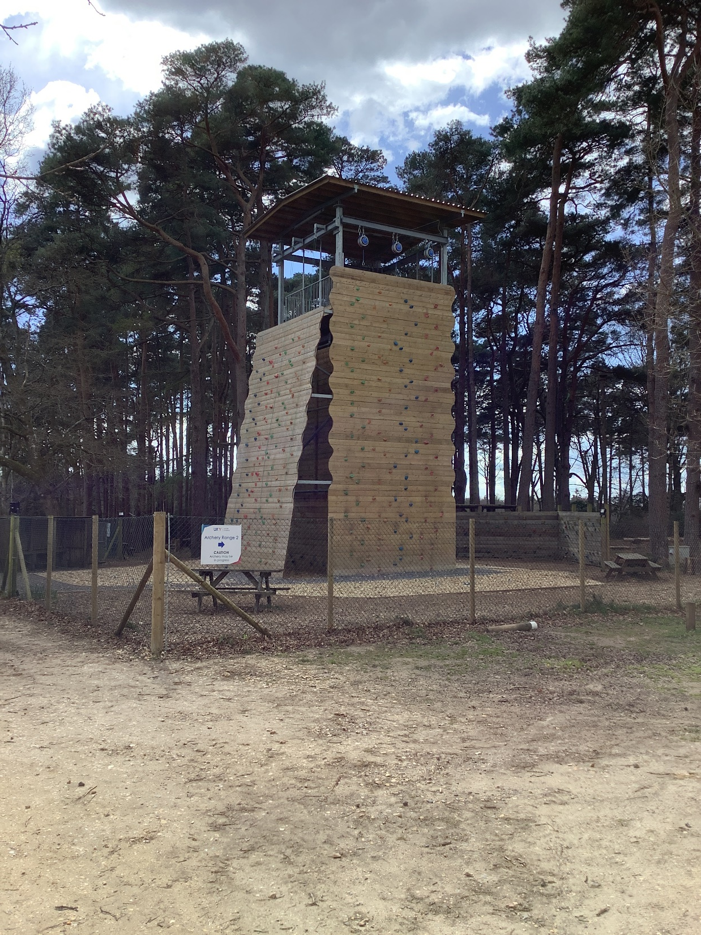
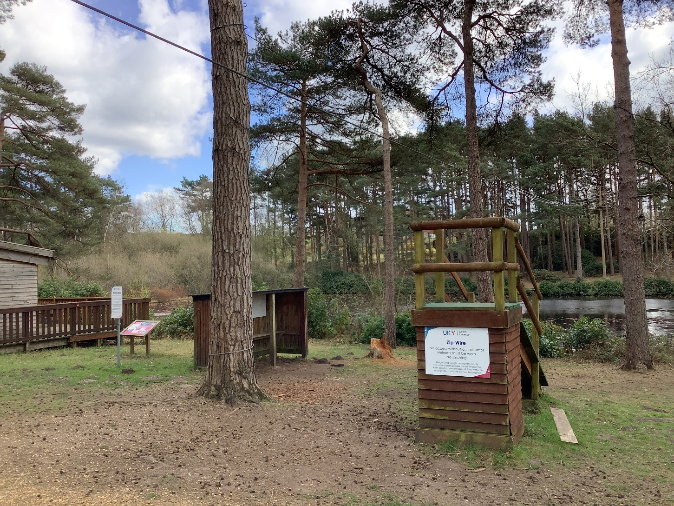

Slide 7
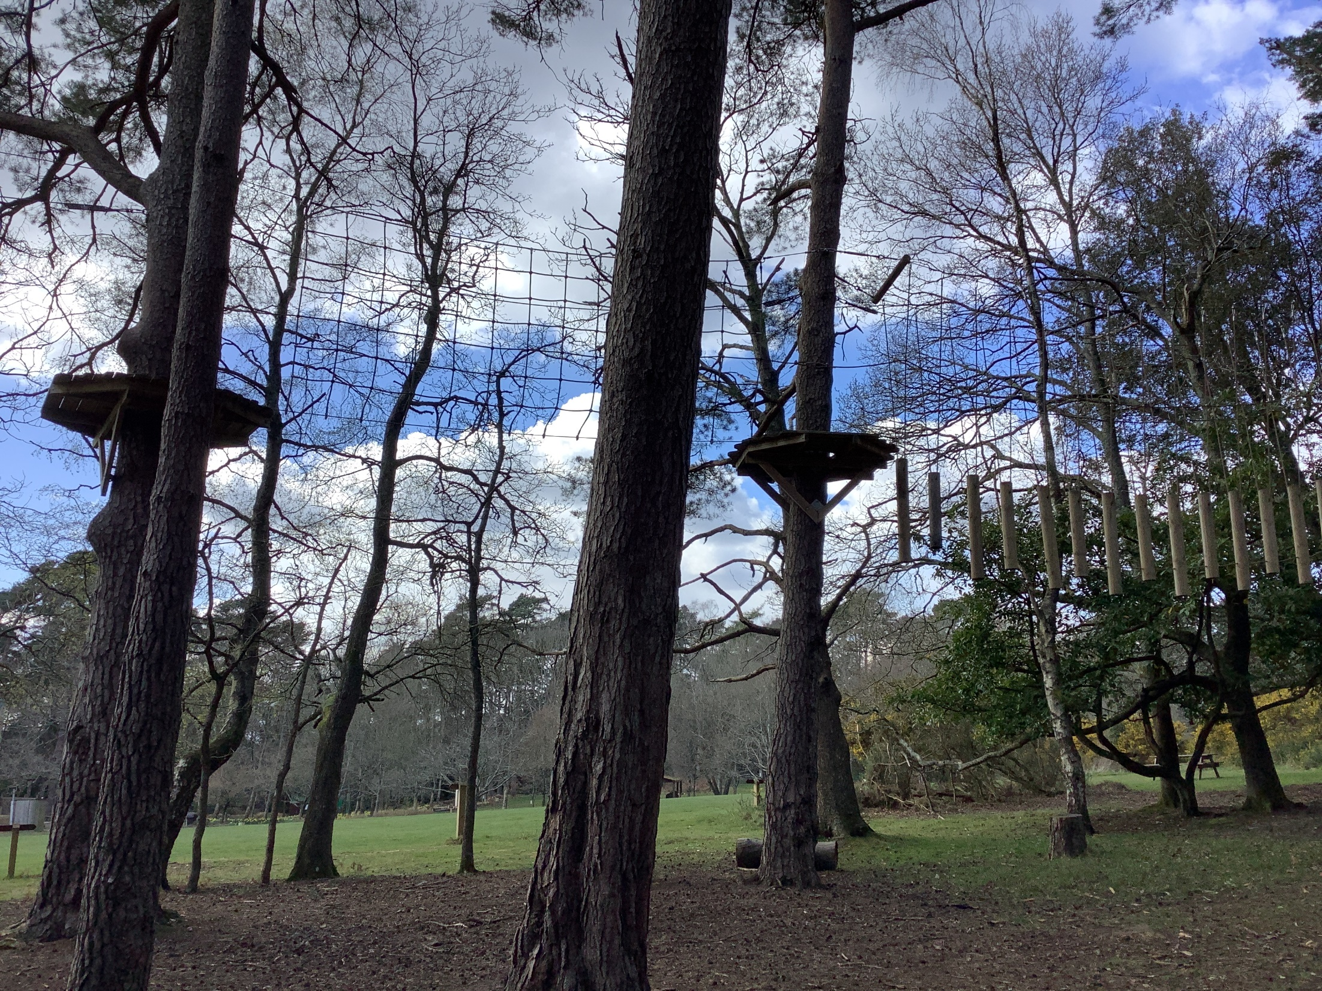

Slide 8
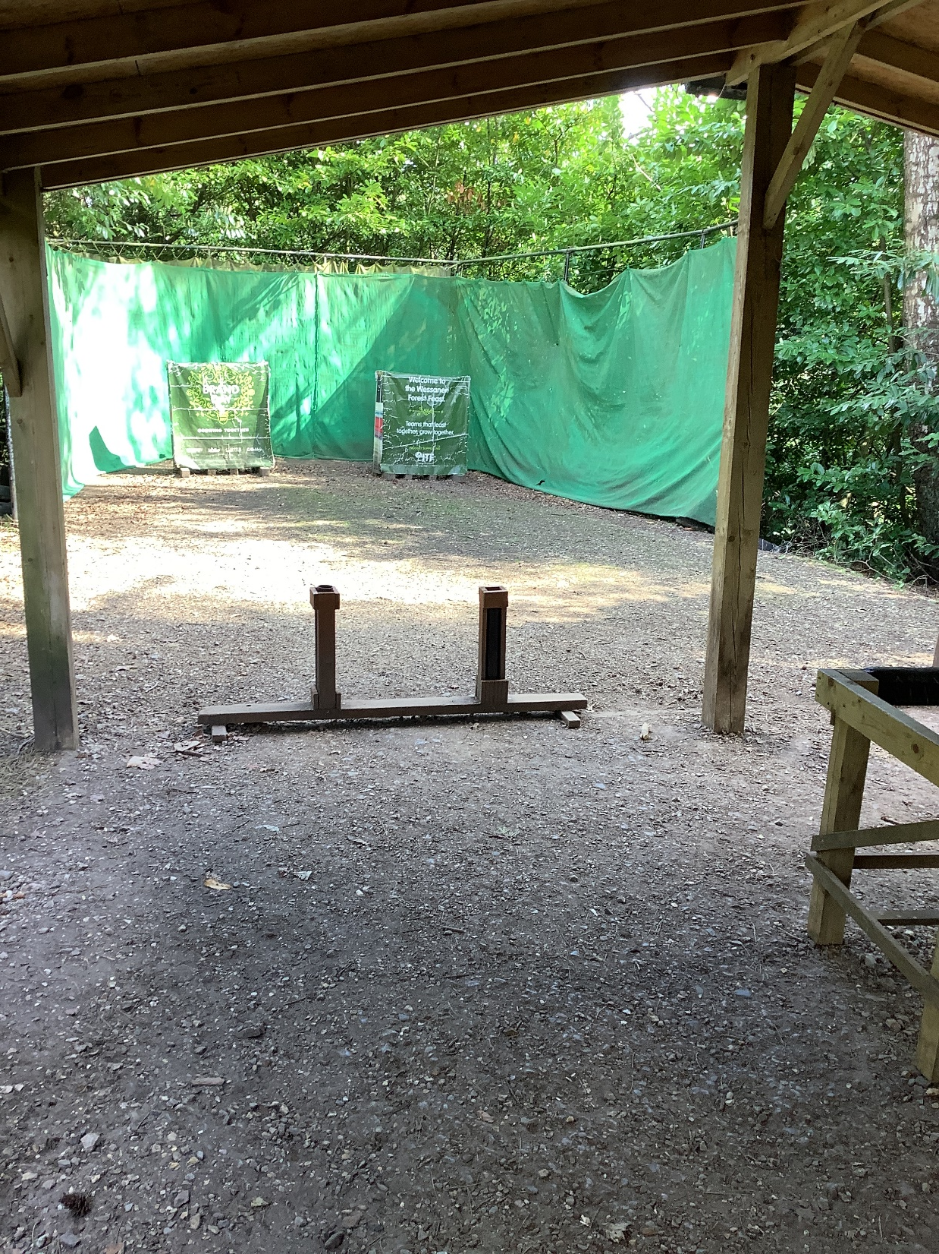

Slide 9
The Oak Package
Abseiling
Climbing
Low ropes
Tree climbing
Zip-wire
Archery
Mountain biking
Egg Drop
Night walk
Bush craft
Treasure Hunt
Guided Games/ sports

Slide 10
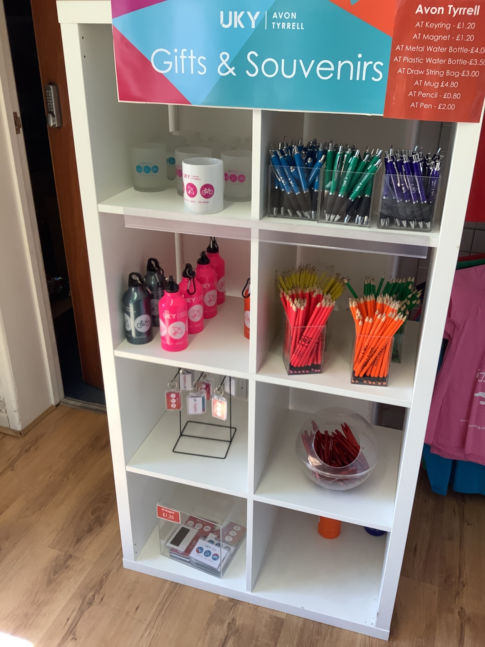

Slide 11
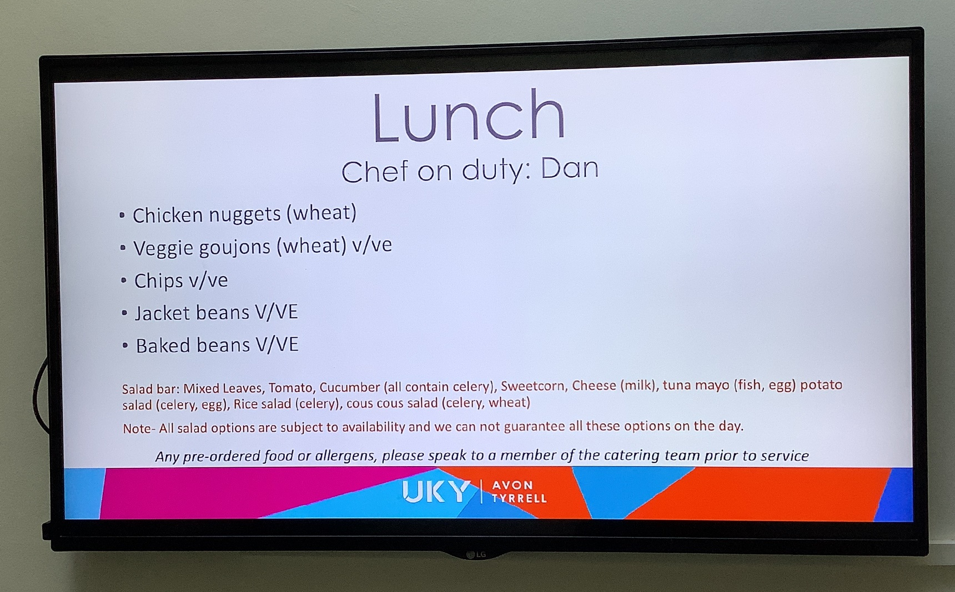

Slide 12
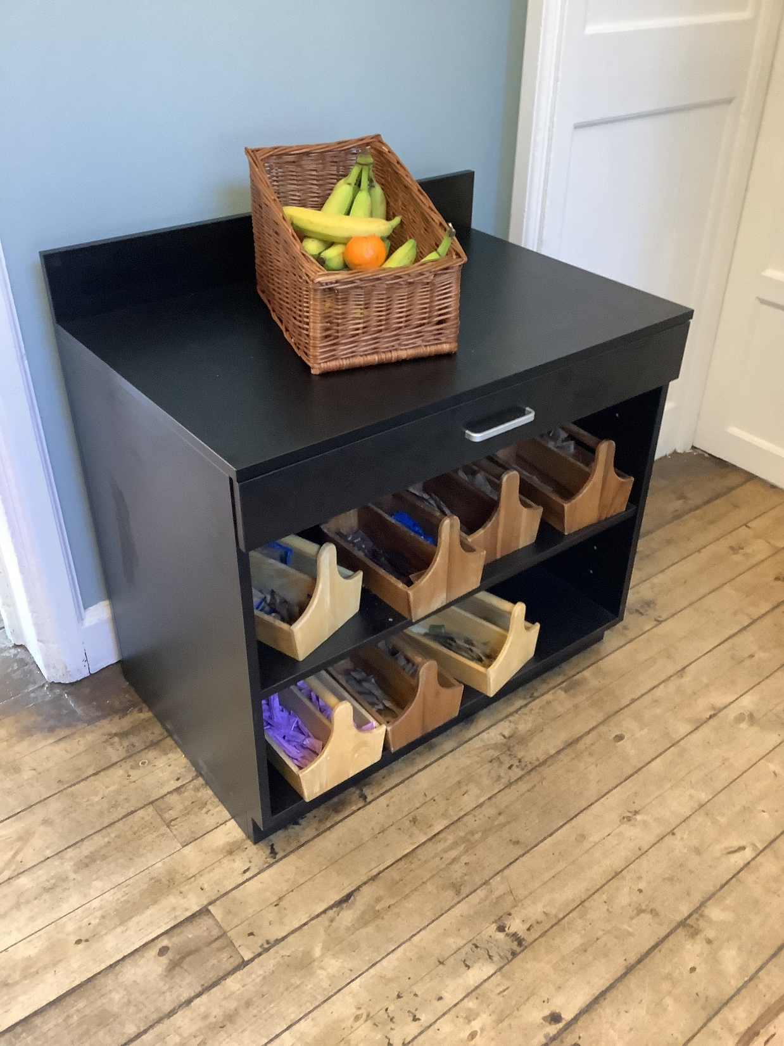
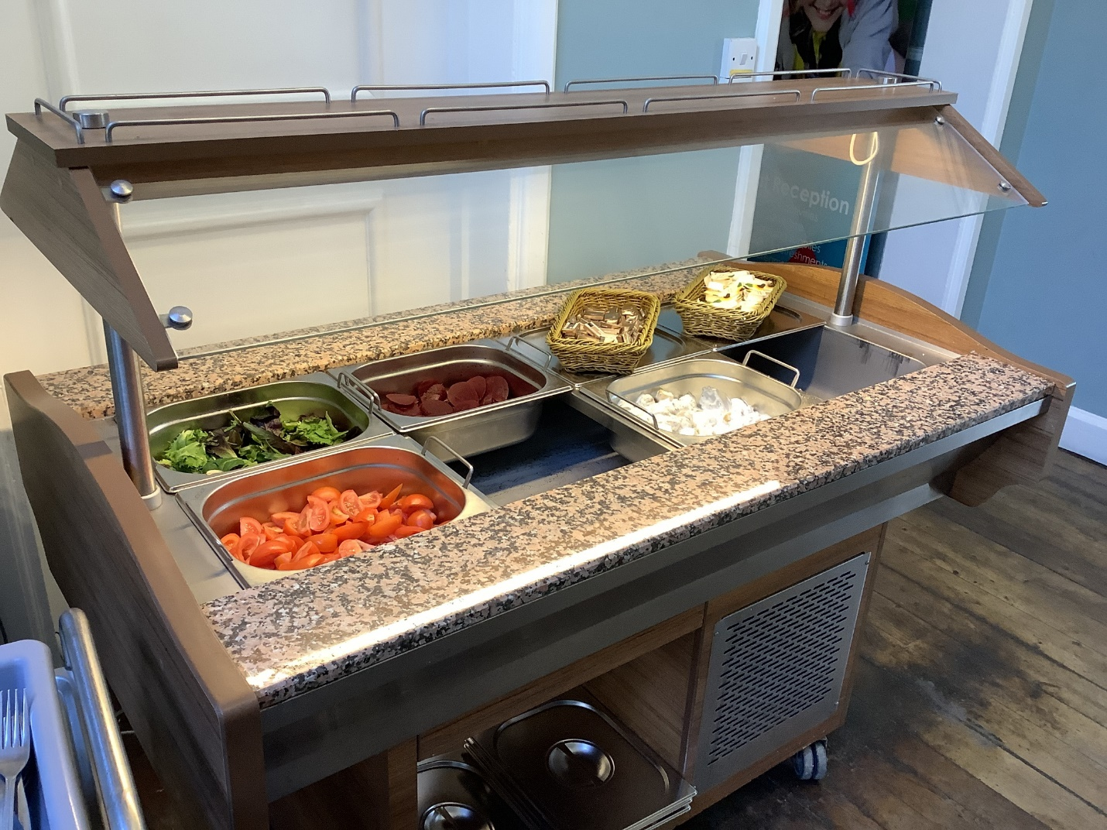

Slide 13
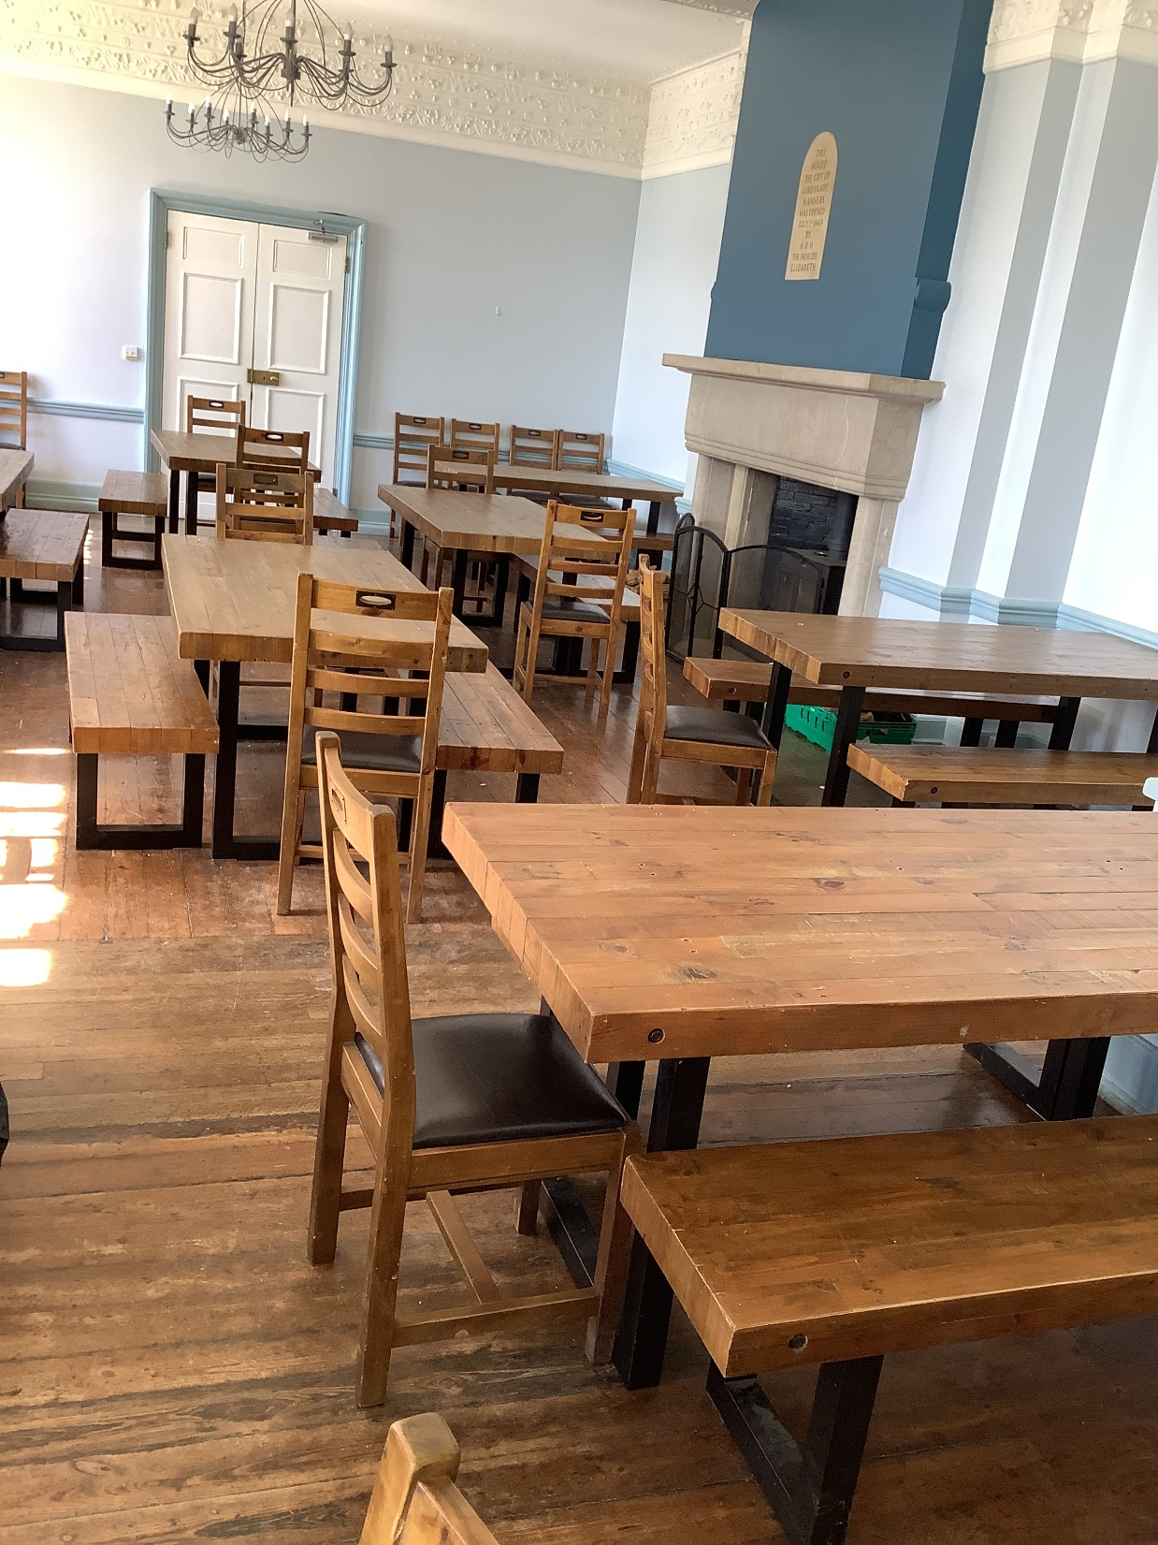
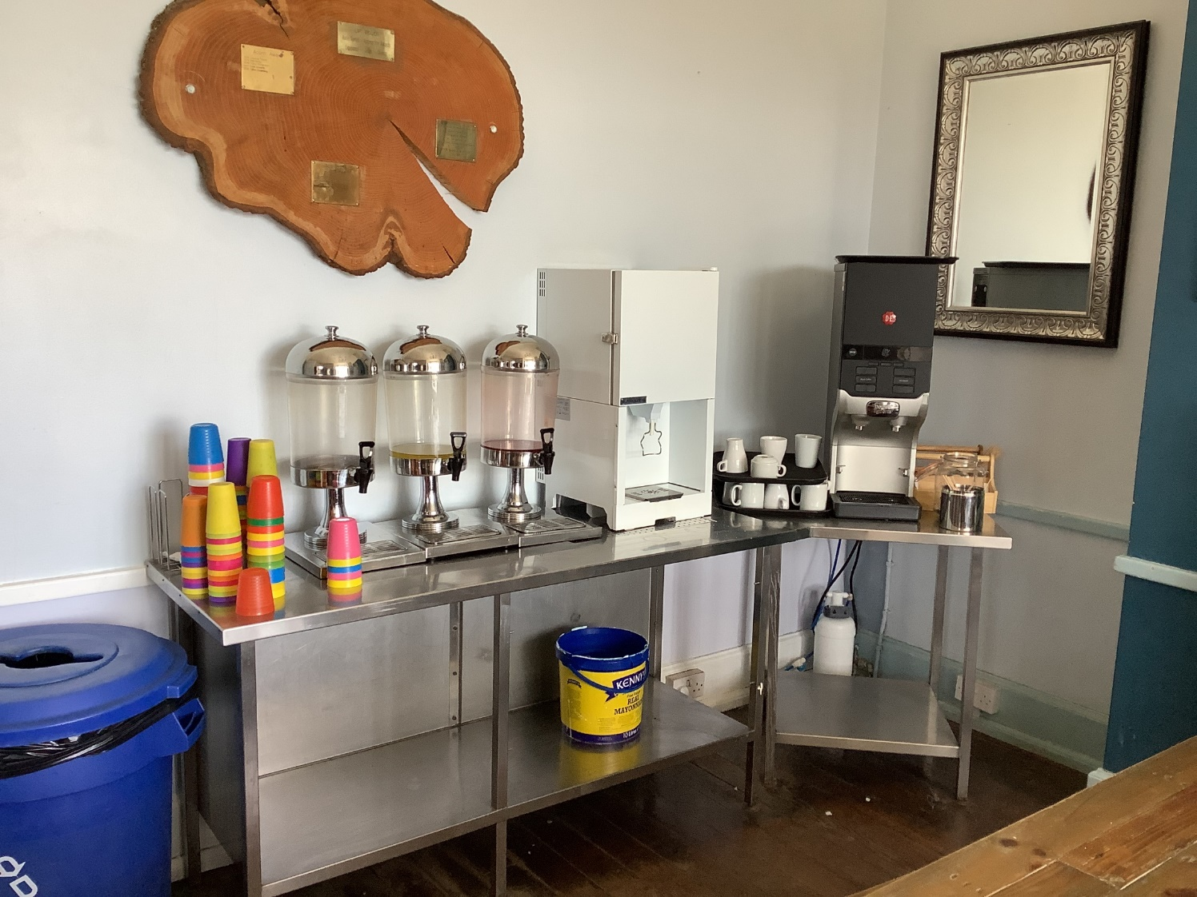

Slide 14
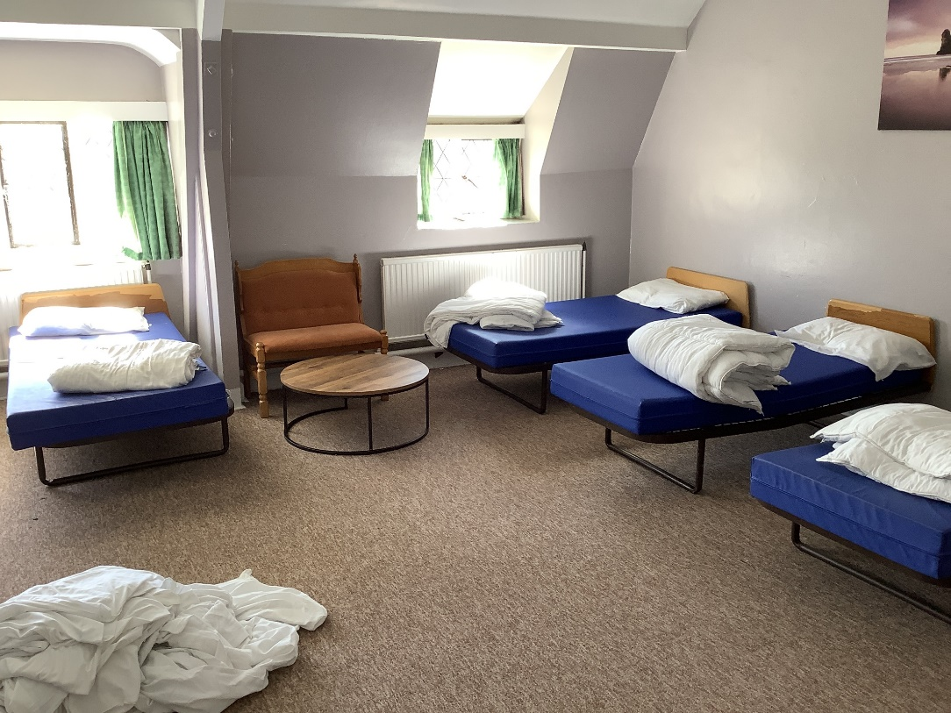
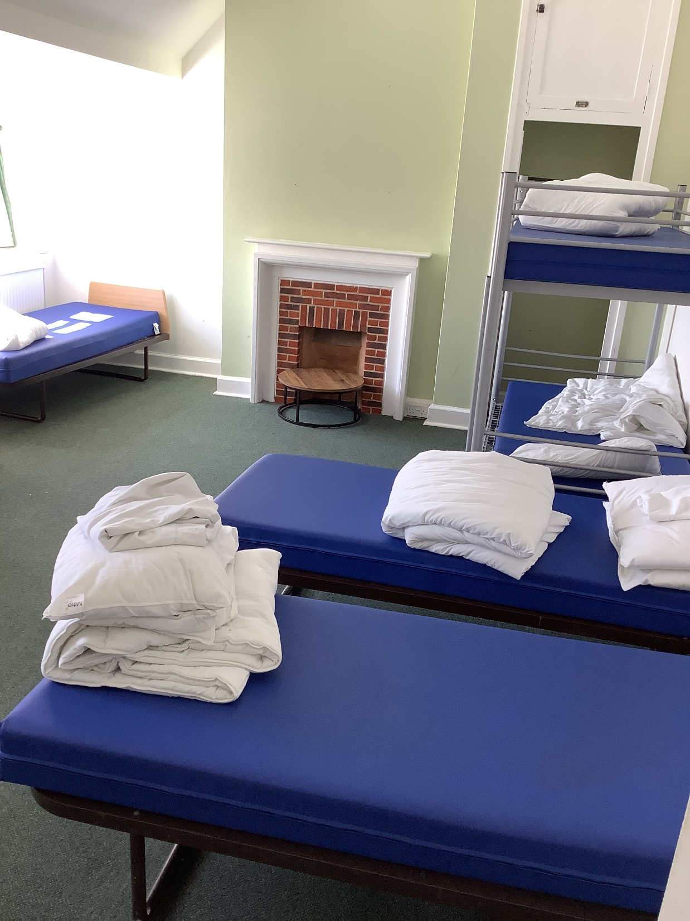
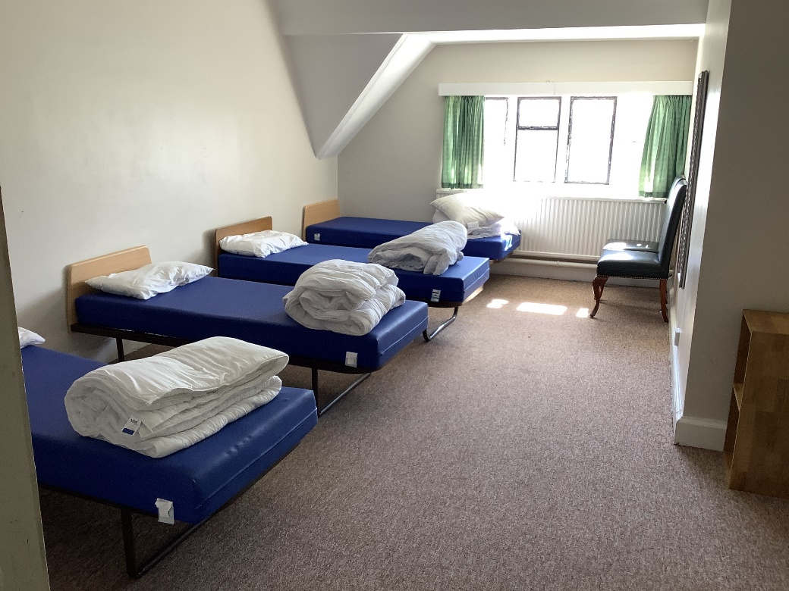

Slide 15
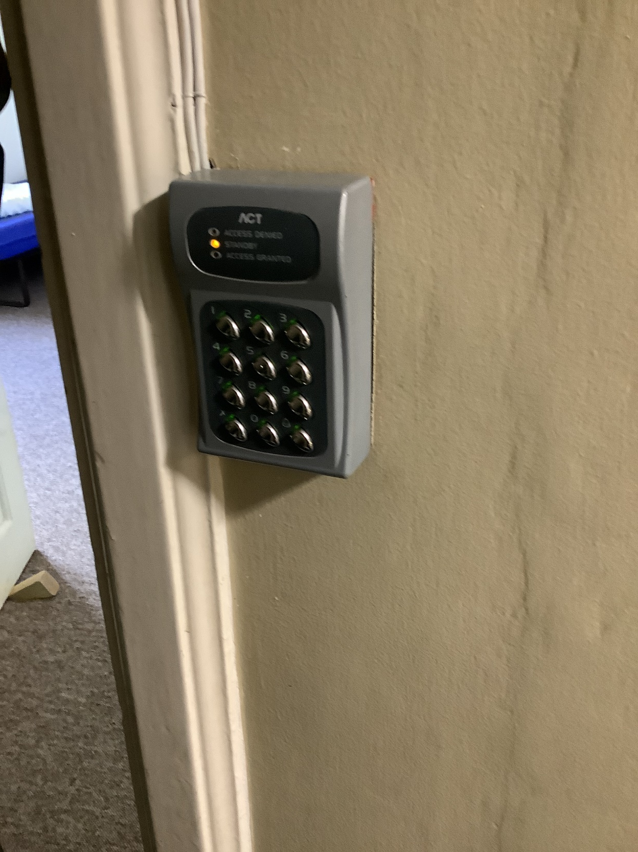

Slide 16
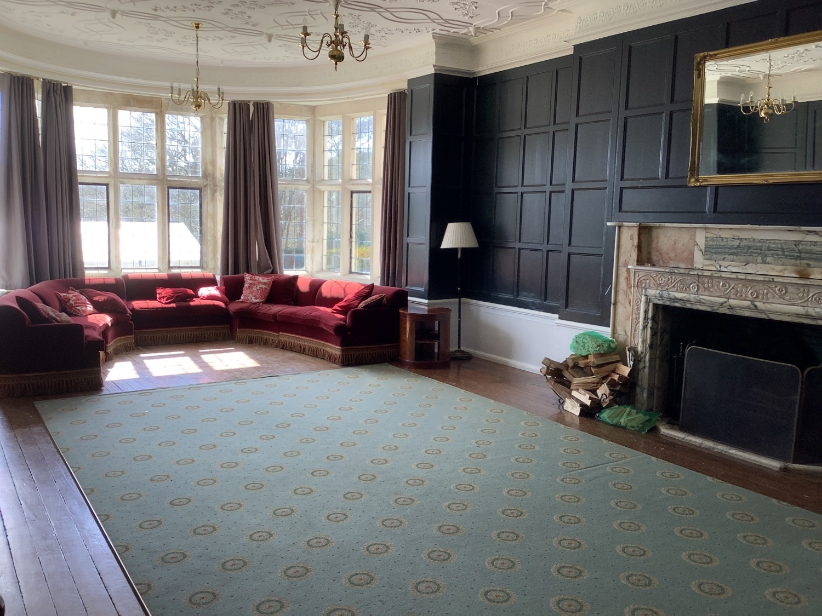
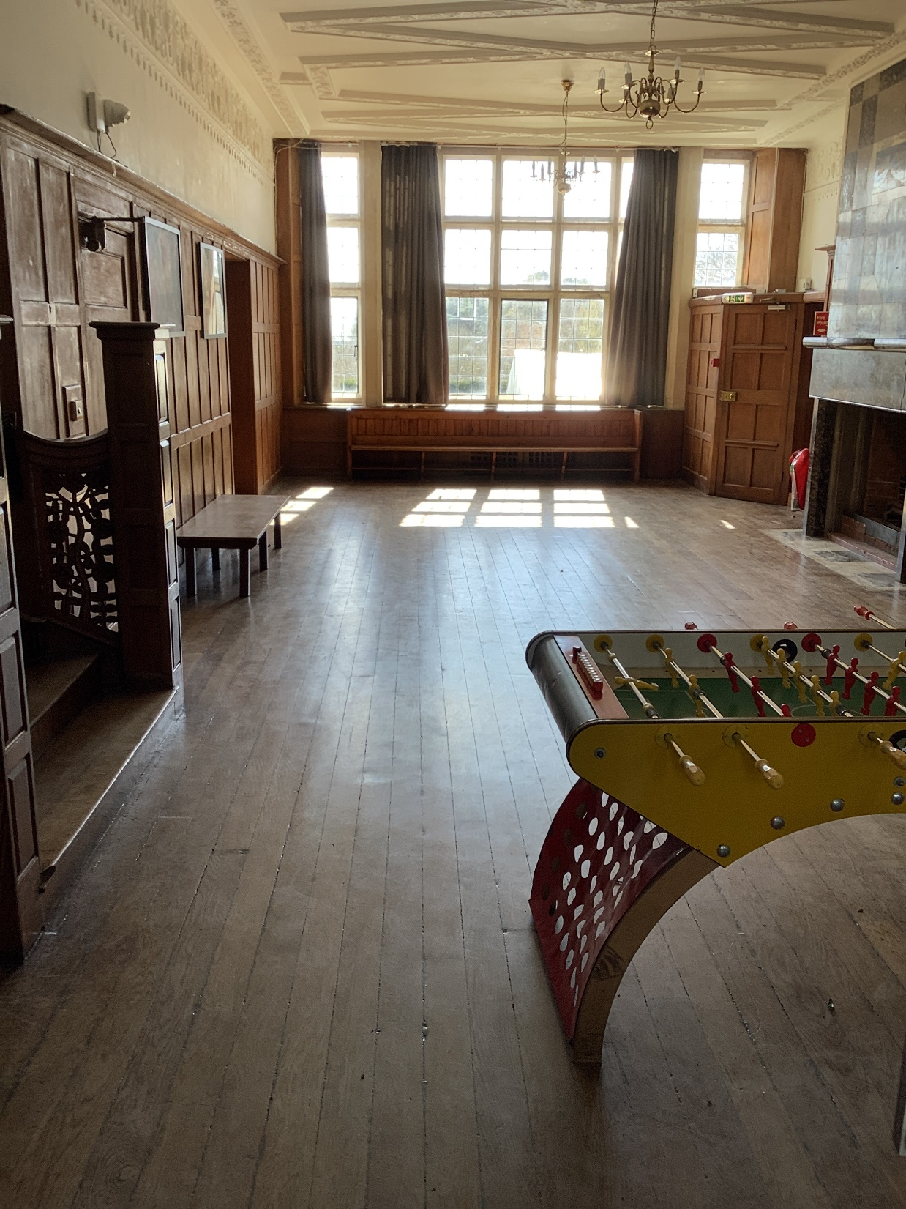
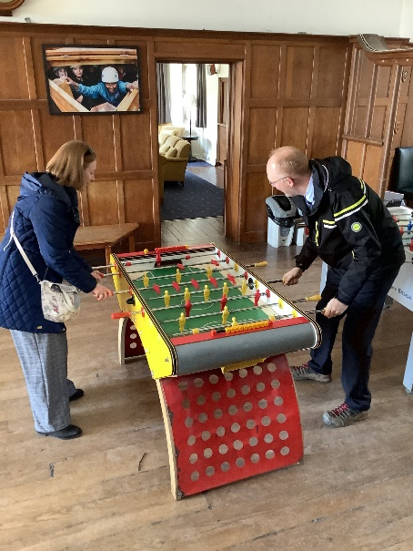

Slide 17
Monday
Children arrive at normal time on Monday morning in non-school uniform. Bring cases to the hall.
Parent to hand medication to the class teacher.
Child to hand pocket money to the class teacher (upstairs).
Back packs (with a water bottle and break time snack) to the classroom.
Coach leaves during the morning.
Say goodbye when you drop them off in the morning!
We will send a text to let you know that we have arrived safely.

Slide 18
During the week…
Groupings – 10-12 per group. Teachers will decide these groups.
Rooms – Children will give suggestions and we really will do our best. Please trust us.
Activities (there is a disco).
Behaviour!
Cleanliness – there will be a daily room inspection and points are also awarded for settling quickly at night and staying quiet in the morning.
Meals – 3 meals a day

Slide 19
Top Tips
Packing – get your child involved
Lots of warm layers
Chill down time is really popular – books, pencil cases, etc.
Plenty of socks
Hats and gloves
Say your goodbyes, then go. Don’t wait for the bus (please)
SLEEP!

Slide 20
Any questions?

